Slide 1
Sprint 1
Spectrum Meet

Slide 2
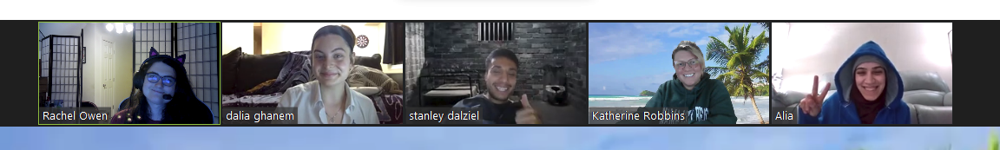
Team OOPsie!
Developers
Designers
Micro-Apps

Slide 3
Spectrum Meet
Spectrum Meet is a platform created to help families with neurodivergent children form and create friendships in a more understanding and supportive environment.

Slide 4
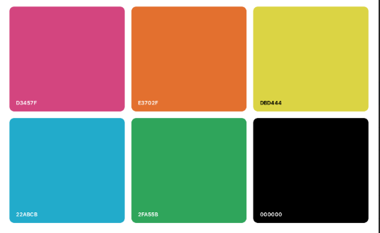
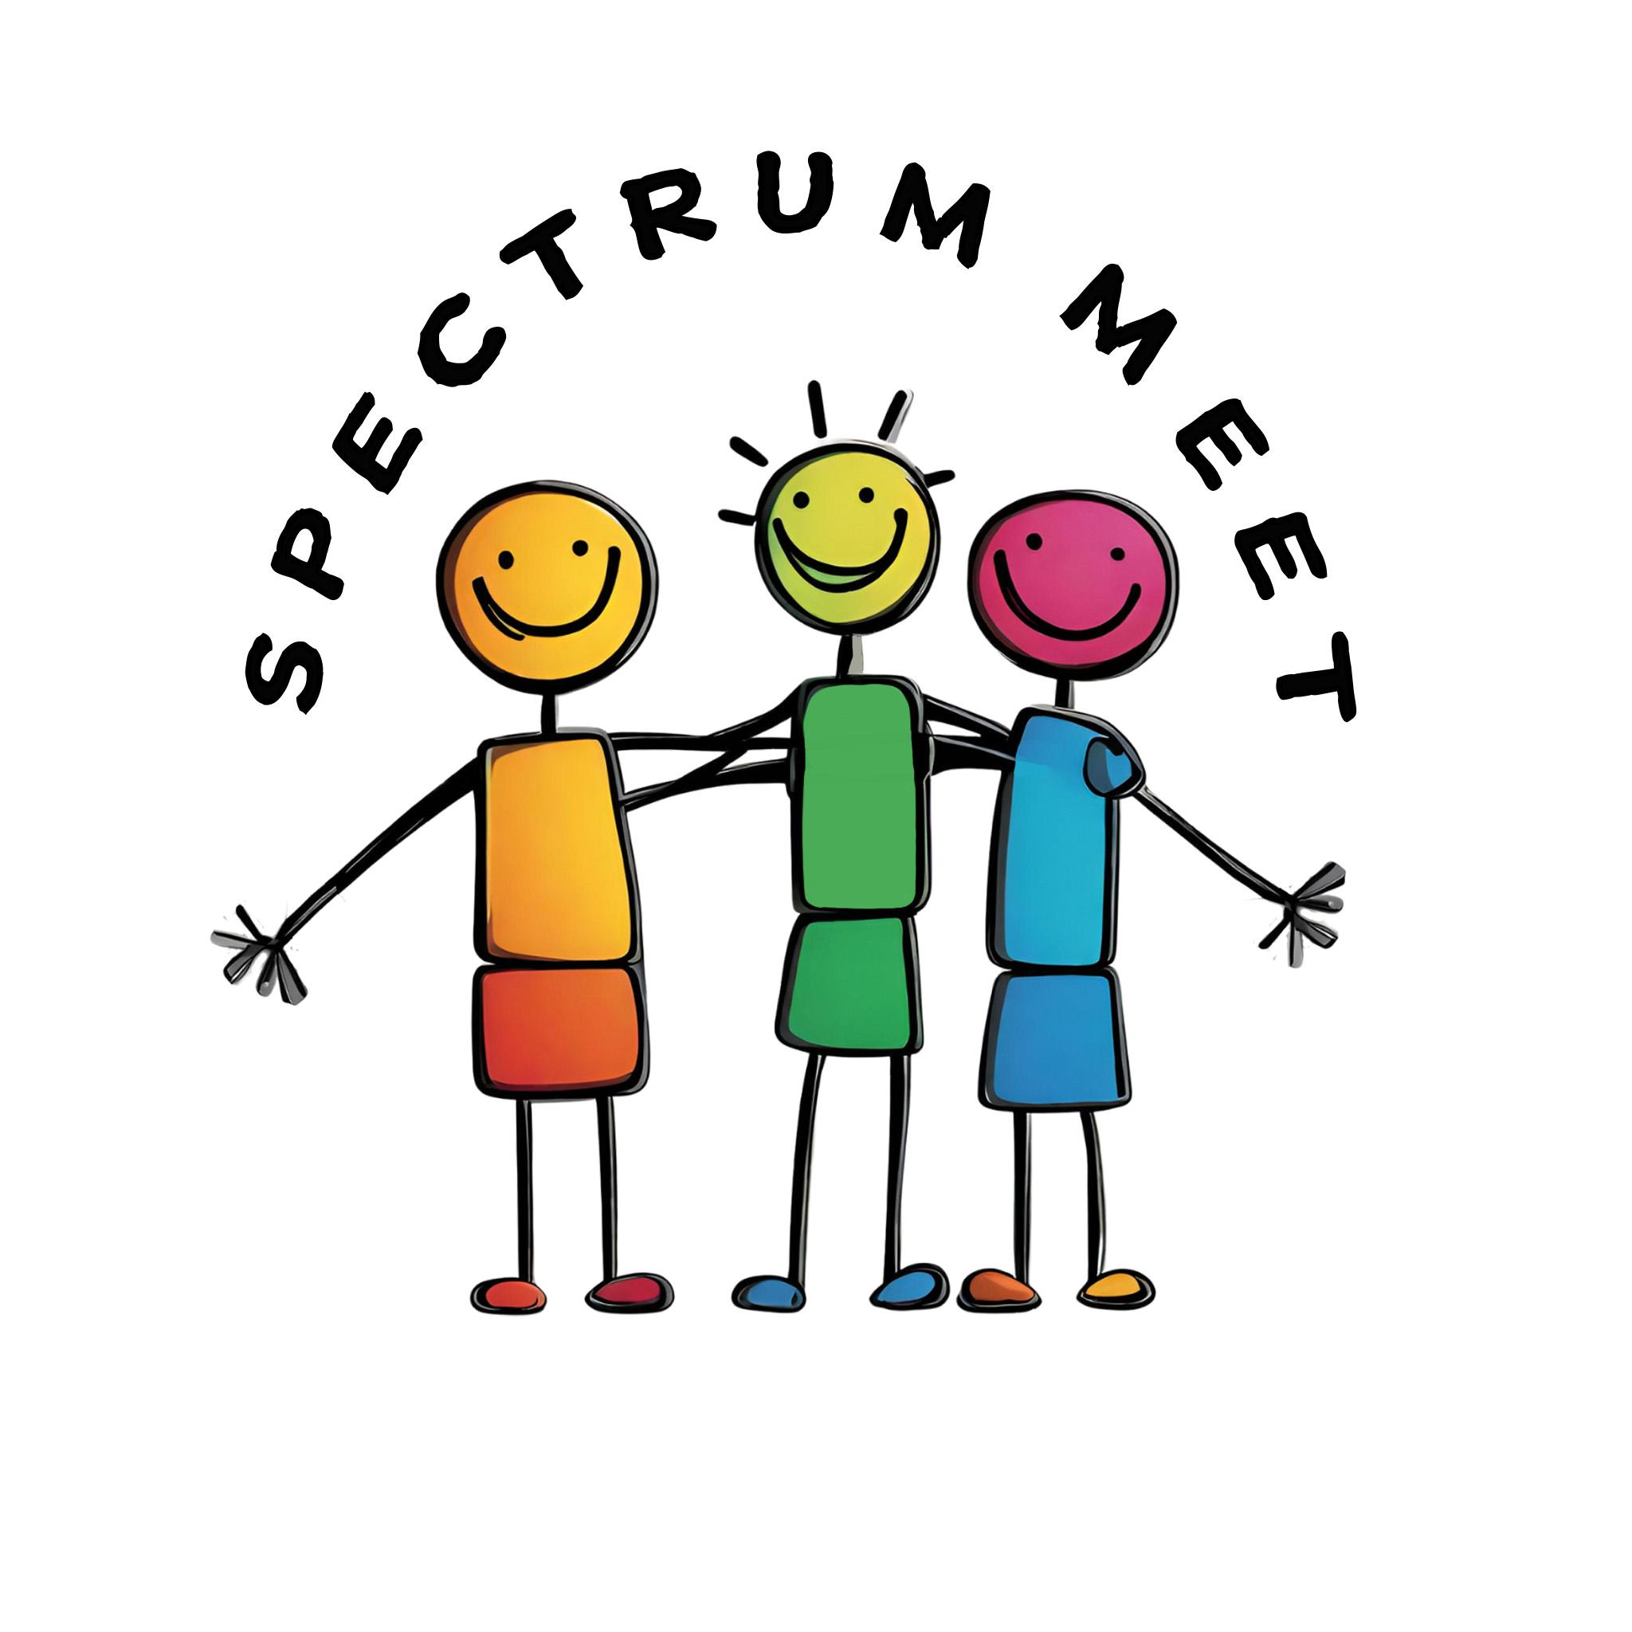
Web Design-Logo & Color Scheme

Slide 5
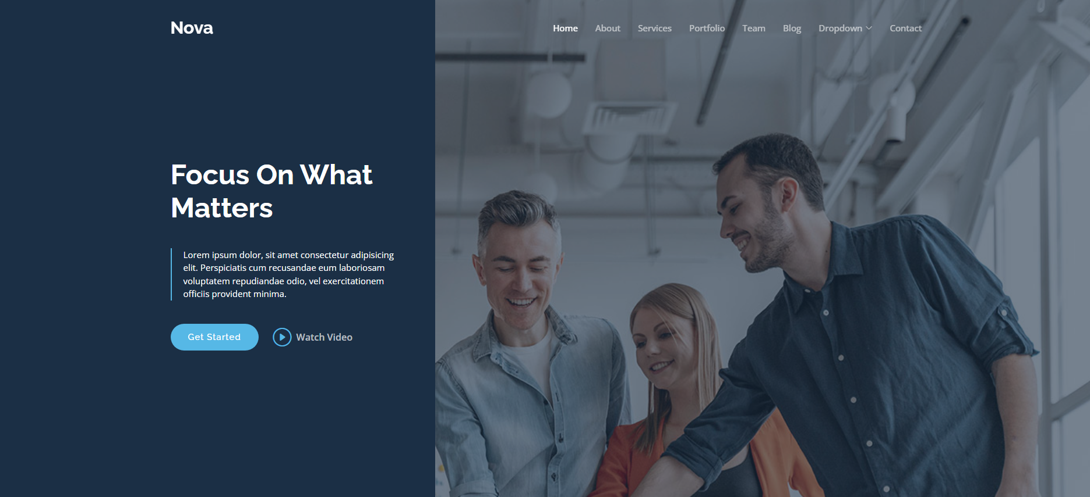
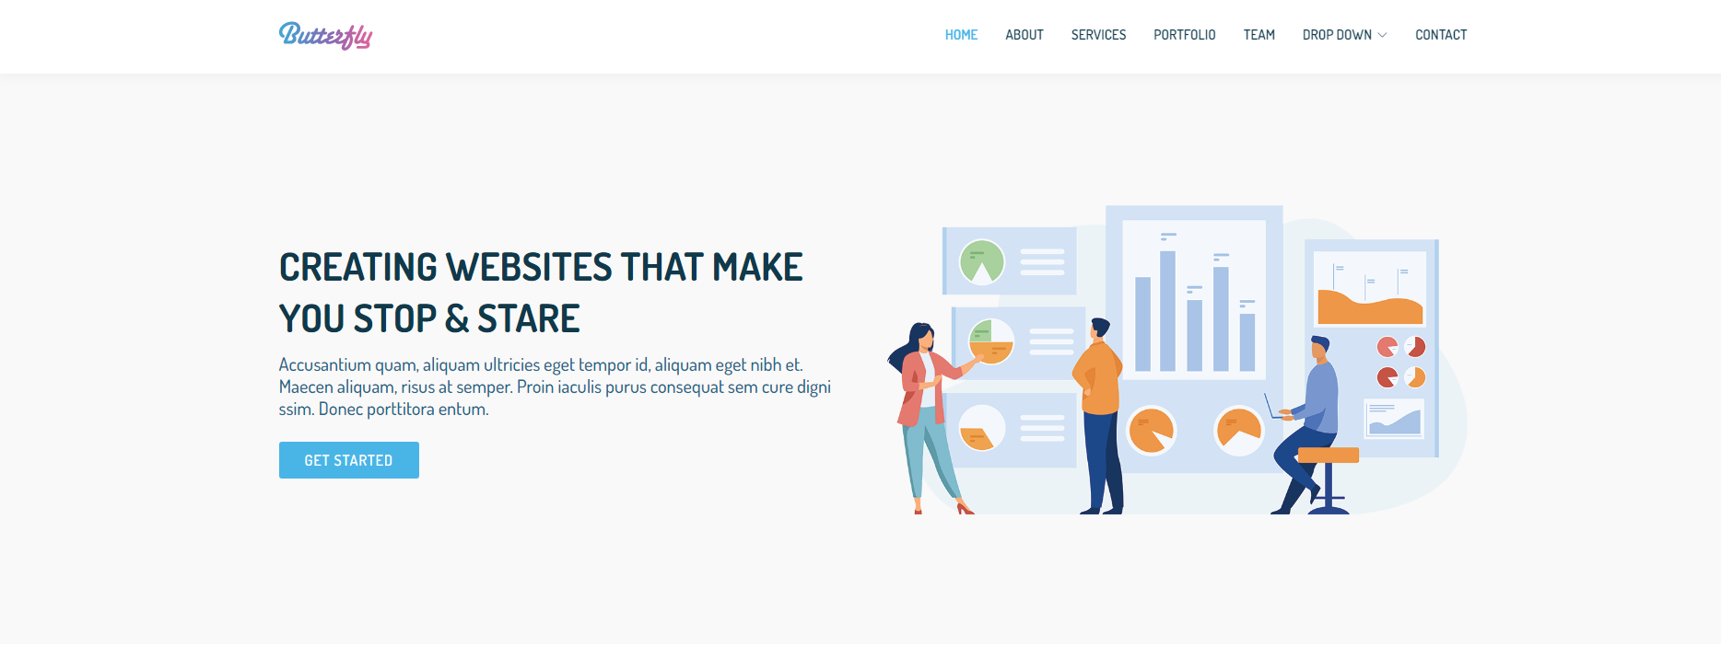
Web Design-Layout
Option 2- https://bootstrapmade.com/demo/Butterfly/
Option 1-https://bootstrapmade.com/demo/Nova/

Slide 6
Web Design- Typography
Lato - used as header font
Whereas recognition of the inherent dignity
Roboto - used for body font
Spectrum Meet!
Whereas disregard and contempt
Welcome to our website!

Slide 7
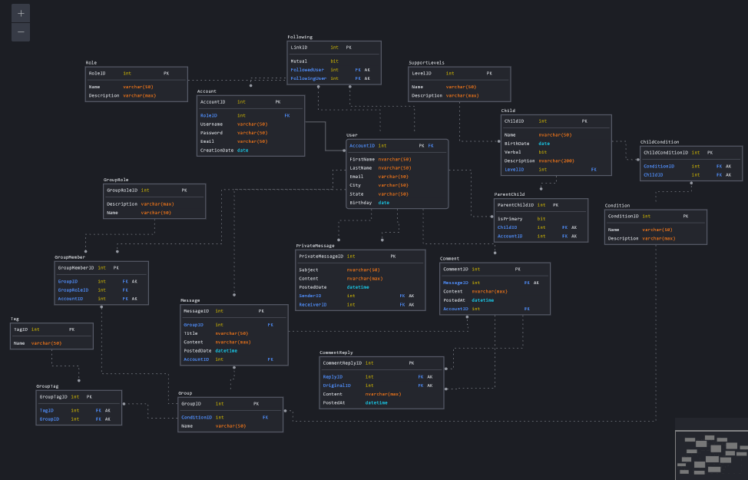
Development
Constructed and modified the ERD to fit our specified features:
Support for an extensible amount of different mental and physical conditions.
Message Boards for parents to connect with each other.
Support for comments and replies on message boards
A tagging system to search by location, condition, age group, etc.
Private messaging between accounts
Support for users following each other's profiles to easily reconnect with one another.

Slide 8
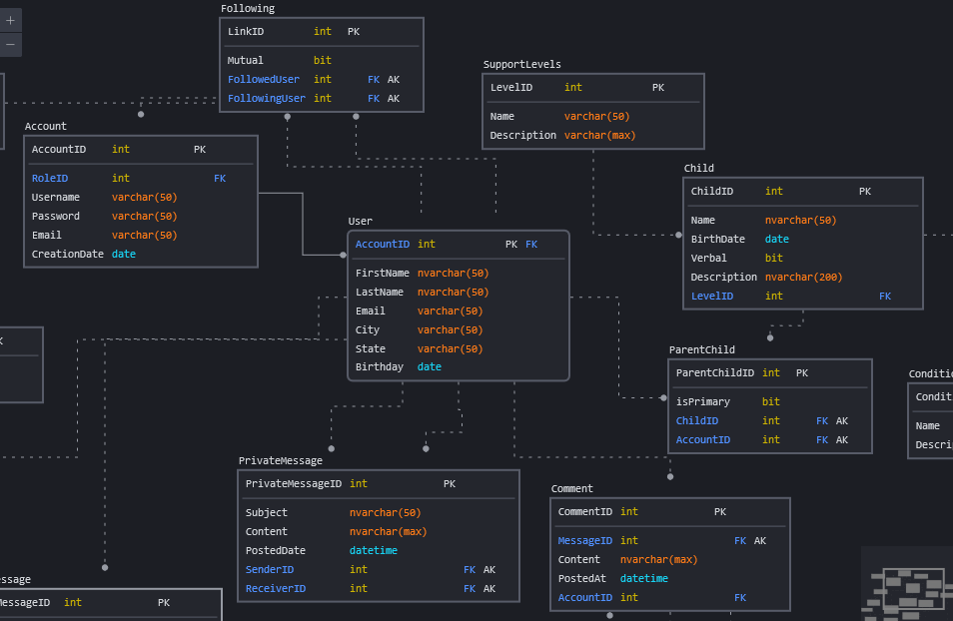
Entity Relationship Diagram
Made 24 Total Revisions before settling on a final design. Complexity increased with features proposed to create a more complete project.

Slide 9
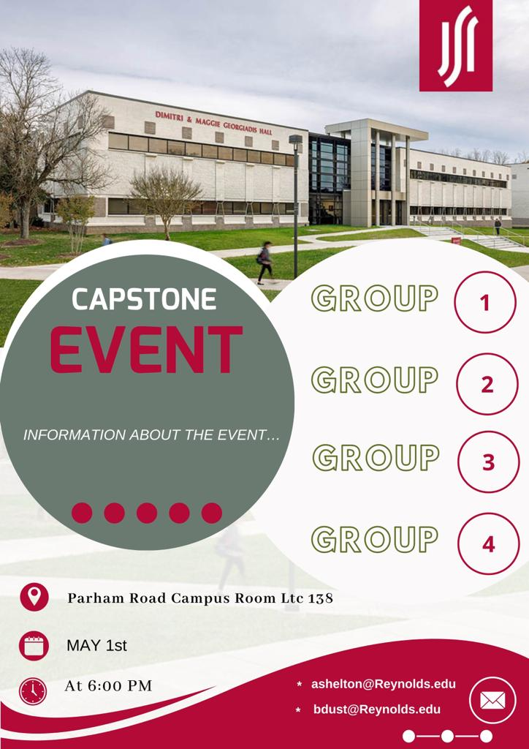
Flyer Design
Created a flyer for the event that fit the requirements.
Createthe design and chose the colors for the flyer .

